Slide 1
How to Build an Industry Cost Profile (ICP) for a product in Mexico
Select the Industry Code Based on the Supplier’s Business and Product
Step 2
Identify Data Sources for Financial and Manufacturing Information Related to Industry Code
Step 3
Use Financial Data to Calculate Ratios for COGS, PBT, GSA & Other Expenses
Step 4
Use Manufacturing Data to Calculate Ratios for DM, DL, and MOH
Step 1

Slide 2
Select the Industry Code Based on the Supplier’s Business and Product
Step 1
Go to:
Conduct a word search to find possible NAICS codes for the product
Select the NAICS code with the best match and record for later use
census.gov/eos/www/naics
Tip: click on the code to view its full definition

Slide 3
Identify Data Sources for Financial and Manufacturing Information Related to Industry Code
Step 2
Mexican Government economic statistics are found at:
Financial data of companies can be found at:
 | Direct Material (DM)
 | Direct Labor (DL)
 | Manufacturing Overhead (MOH)
 | Cost of Goods Sold (COGS)
 | GSA & Other Expenses
 | Profit Before Tax (PBT)
 | Total Sales
Manufacturing data
Source: Mexico Government economic statistics
inegi.org.mx
Financial data
Source: Financial reports of companies
google.com/finance
*You will use these data sources to express DM, DL, MOH, COGS, GSA & Other Expenses and PBT as ratios, in the form of percentages of Total Sales.

Slide 4
Use Financial Data to Calculate Ratios (COGS, PBT, GSA & Other Expenses)
Step 3
From each firms’ Income Statement, use multiple year averages to calculate COGS, GSA & O Exp. and PBT
Use as many firms as you judge necessary to get an accurate representation of the industry you are modelling
Core Molding Technologies (CMT)*
 |  | 2020 | 2019 | 2018 | Average
 | COGS | 89.9% | 84.8% | 84.0% | 86.2%
 | GSA & Other | 12.1% | 10.4% | 9.5% | 10.7%
 | PBT | -2.0% | 4.8% | 6.4% | 3.1%
 | Total Sales | 100% | 100% | 100% | 100%
*Example firm from the Plastic Manufacturing Industry that has operations in Mexico.
$$COGS \%=\frac{COGS}{Total Sales}$$
$$PBT \%=\frac{PBT}{Total Sales}$$
GSA & O. Exp. % = Total sales (100%) – COGS % – PBT %

Slide 5
Use Financial Data to Calculate Ratios (COGS, PBT, GSA & Other)
Step 3
Average the ratios of the selected firms to create your industry ratios
Selected firms in the plastics manufacturing industry*
 |  | Firm 1 | Firm 2 | … | Firm 7 | Average
 | COGS | 86% | 79% | … | 76% | 77.6%
 | GSA & Other | 10% | 17% | … | 19% | 17.8%
 | PBT | 3% | 4% | … | 5% | 4.6%
 | Total Sales | 100% | 100% | … | 100% | 100%
*Example data for illustration purposes only

Slide 6
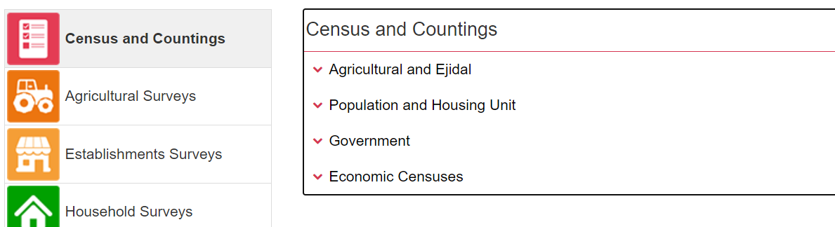
Use Manufacturing Data to Calculate Ratios (DM, DL, and MOH)
Step 4
In Mexico, follow 12 steps to find DM, DL, and MOH.
1. Go to:
And click on top item “Data” or “Datos”
2. Find and click on “Programas” or “Programs”
3. Find and click on “Censos Economicos” or “Economic Census”. Then select the year.
inegi.org.mx

Slide 7
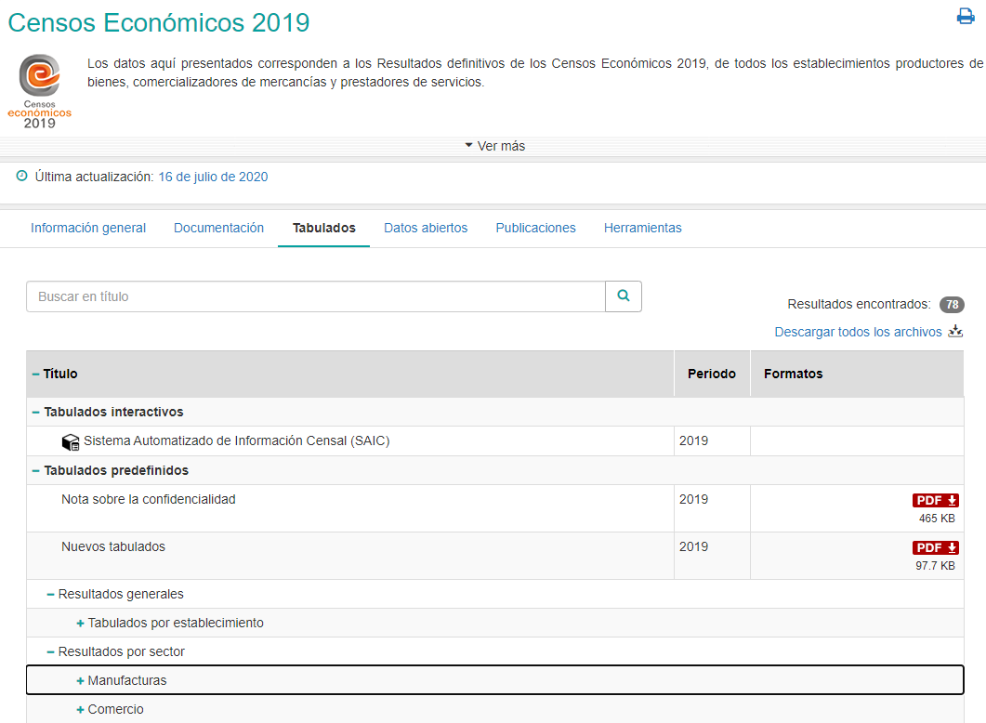
Use Manufacturing Data to Calculate Ratios (DM, DL, and MOH)
Step 4
4. Click on the tab labelled “Tabulados” (switch to Spanish if you cant find it under English)
5. Under “Tabulados Interactivos” (“Iteractive tabs”) click on “Sistema Automatizado de Informacion Censal (SAIC)” (Automated Census Information System)

Slide 8
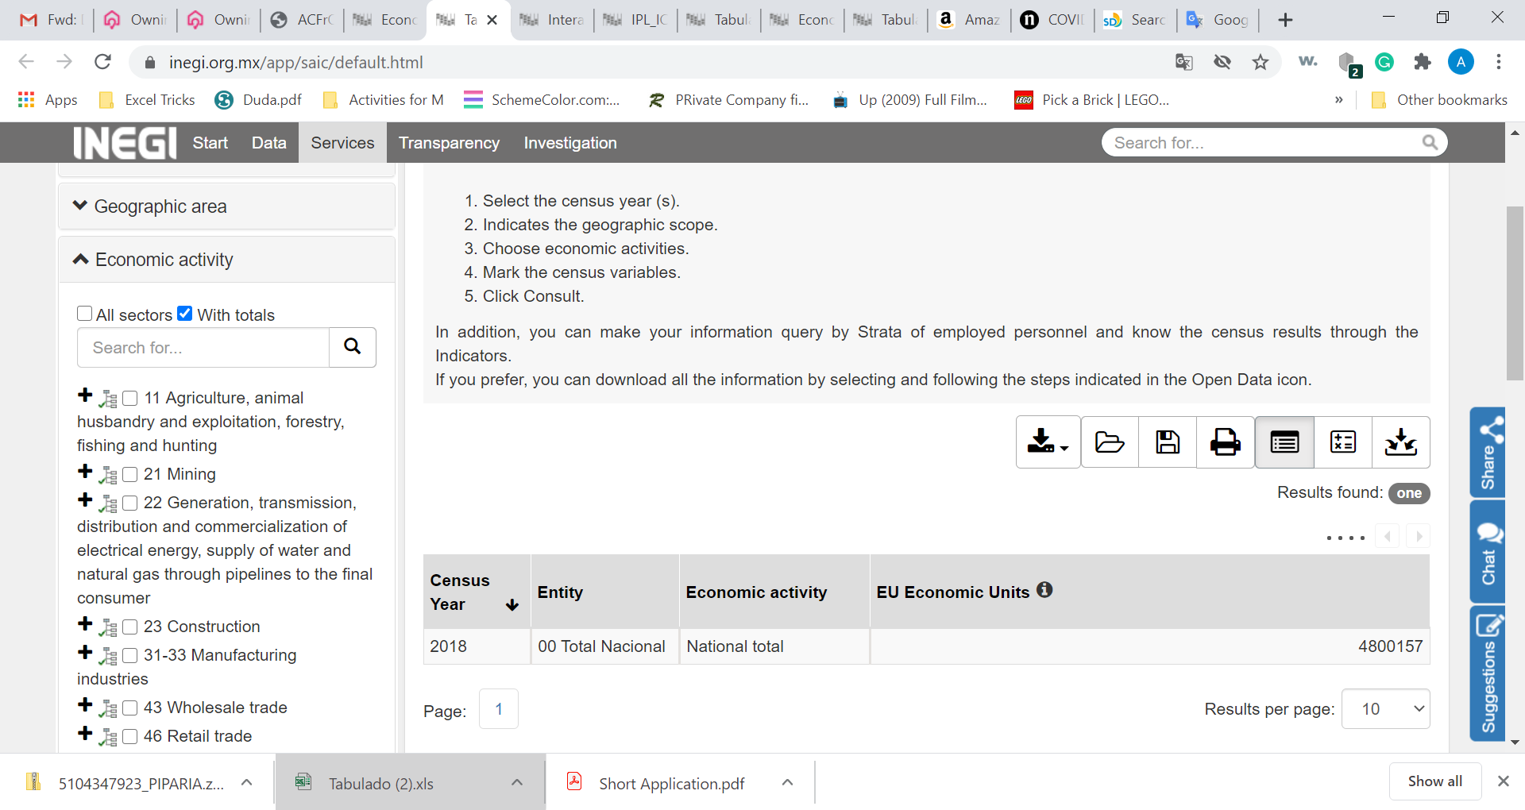
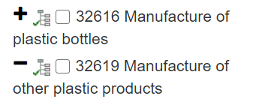
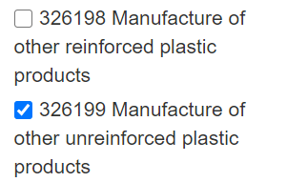
Use Manufacturing Data to Calculate Ratios (DM, DL, and MOH)
Step 4
6. The following window will have the first two variables selected – Census year and geographic scope
7. Next select Economic activity by navigating the NAICS tree on the left to code identified in slide 2 (326199)

Slide 9
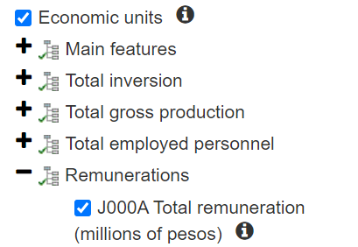
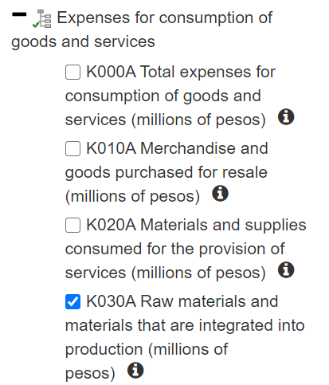
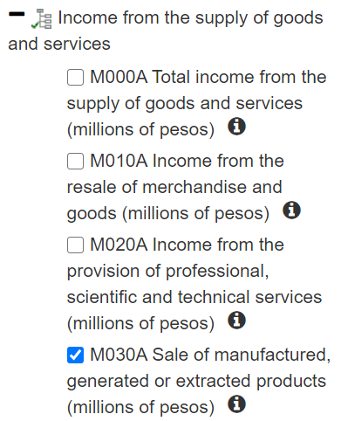
Use Manufacturing Data to Calculate Ratios (DM, DL, and MOH)
Step 4
6. Next select the “Census Variables” by scrolling beyond the economic activity
7. From the list of variables select the following variables:
J000A Total Renumerations
K030A Raw materials and materials that are integrated into production
M030A Sales of manufactured, generated or extracted products
8. Then click “Consult”

Slide 10
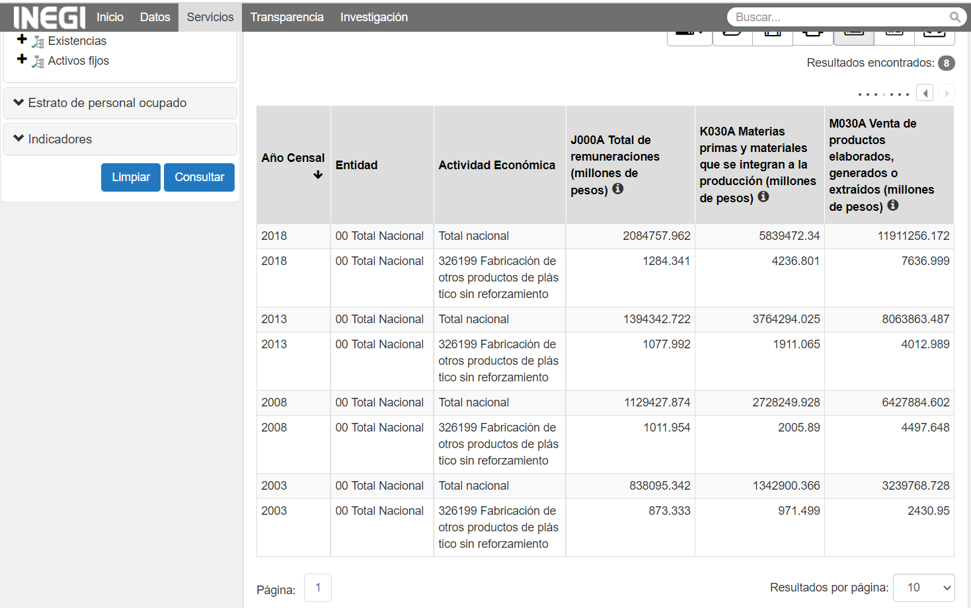
Use Manufacturing Data to Calculate Ratios (DM, DL, and MOH)
Step 4
9. Note values for:
Remuneraciones
Materias Primas
Venta de Productos
Note: Remuneraciones will be applied to an industry ratio of Direct Labor to Total Labor. We will explain how to estimate this ratio in the next slide.

Slide 11
Use Manufacturing Data to Calculate Ratios for DM, DL, and MOH
Step 4
10. Use the U.S. Occupational Employment Statistics to calculate the Direct Labor to Total Labor ratio
See the procedure:
Direct-to-Total Labor Ratio

Slide 12
Use Manufacturing Data to Calculate Ratios for DM, DL, and MOH
Step 4
11. Apply the Direct to Total Labor ratio to ‘Remuneraciones’ to obtain an estimate of Direct Labor cost, in the case we will use 63%
12. Use the Direct Labor cost to calculate the Direct Labor Ratio
 | Remuneraciones | $1,281.34
 | Direct to Total Labor ratio | x 63 %
 | Direct Labor | $807.24
 | Remuneraciones | $807.24
 | Venta de productos | $7,636.99
 | Direct Labor Ratio | 10.6%
15.
16.

Slide 13
Use Manufacturing Data to Calculate Ratios for DM, DL, and MOH
Step 4
13. Calculate the Direct Material (DM) Ratio
14. Back out the Material Overhead (MOH) Ratio:
 | Materias primas | $4,236.80
 | Venta de productos | $7,636.99
 | Direct Material | 55.47%
 | Cost of Goods Sold (COGS) | 77.6%
 | less Direct Material (DM) | - 55.5%
 | less Direct Labor (DL) | - 10.6%
 | Manufacturing Overhead (MOH) | 11.5%
17.
18.
MOH = COGS – DM –DL

Slide 14
Present all your calculated ratios in the cost breakdown format
Industry cost profile for the plastics manufacturing industry
 | Direct Material (DM) | 55.5%
 | Direct Labor (DL) | 10.6%
 | Manufacturing Overhead (MOH) | 11.5%
 | Cost of Goods Sold (COGS) | 77.6%
 | GSA & Other | 17.8%
 | Profit Before Tax (PBT) | 4.6%
 | Total Sales | 100.0%
Ratios calculated from U.S. and Mexico government economic statistics
Ratios calculated from companies’ financial data

Slide 15
References and summary of ICP calculations
Cost Element | % of Sales | Calculation | Order
DM | 55.5% | = C / F | 4
DL | 10.6% | = (D * E) / F | 5
MOH | 11.5% | = COGS - DM - DL | 6
COGS | 77.6% | = A | 1
GSA | 18% | = Total - COGS - PBT | 3
PBT | 4.6% | = B | 2
TOTAL | 100%
SUMMARY OF DATA
 | Data point | Value | Source
A | Cost of Goods Sold | 77.6% | Average of represntative firm's financials
B | PBT | 4.6% | Average of represntative firm's financials
C | Materias primas (Direct Material) | 4,236 | Inegi; Sistema Automatizado de Información Censal (SAIC): NAICS 326199
D | Remuneraciones (Total Labor) | 1,284 | Inegi; Sistema Automatizado de Información Censal (SAIC): NAICS 326199
E | Direct to Total Labor ratio | 63% | U.S. Census Bureau, Occupational Employment Statistics: NAICS 326199
F | Venta de productos (Total Sales) | 7,636 | Inegi; Sistema Automatizado de Información Censal (SAIC): NAICS 326199

